Slide 1
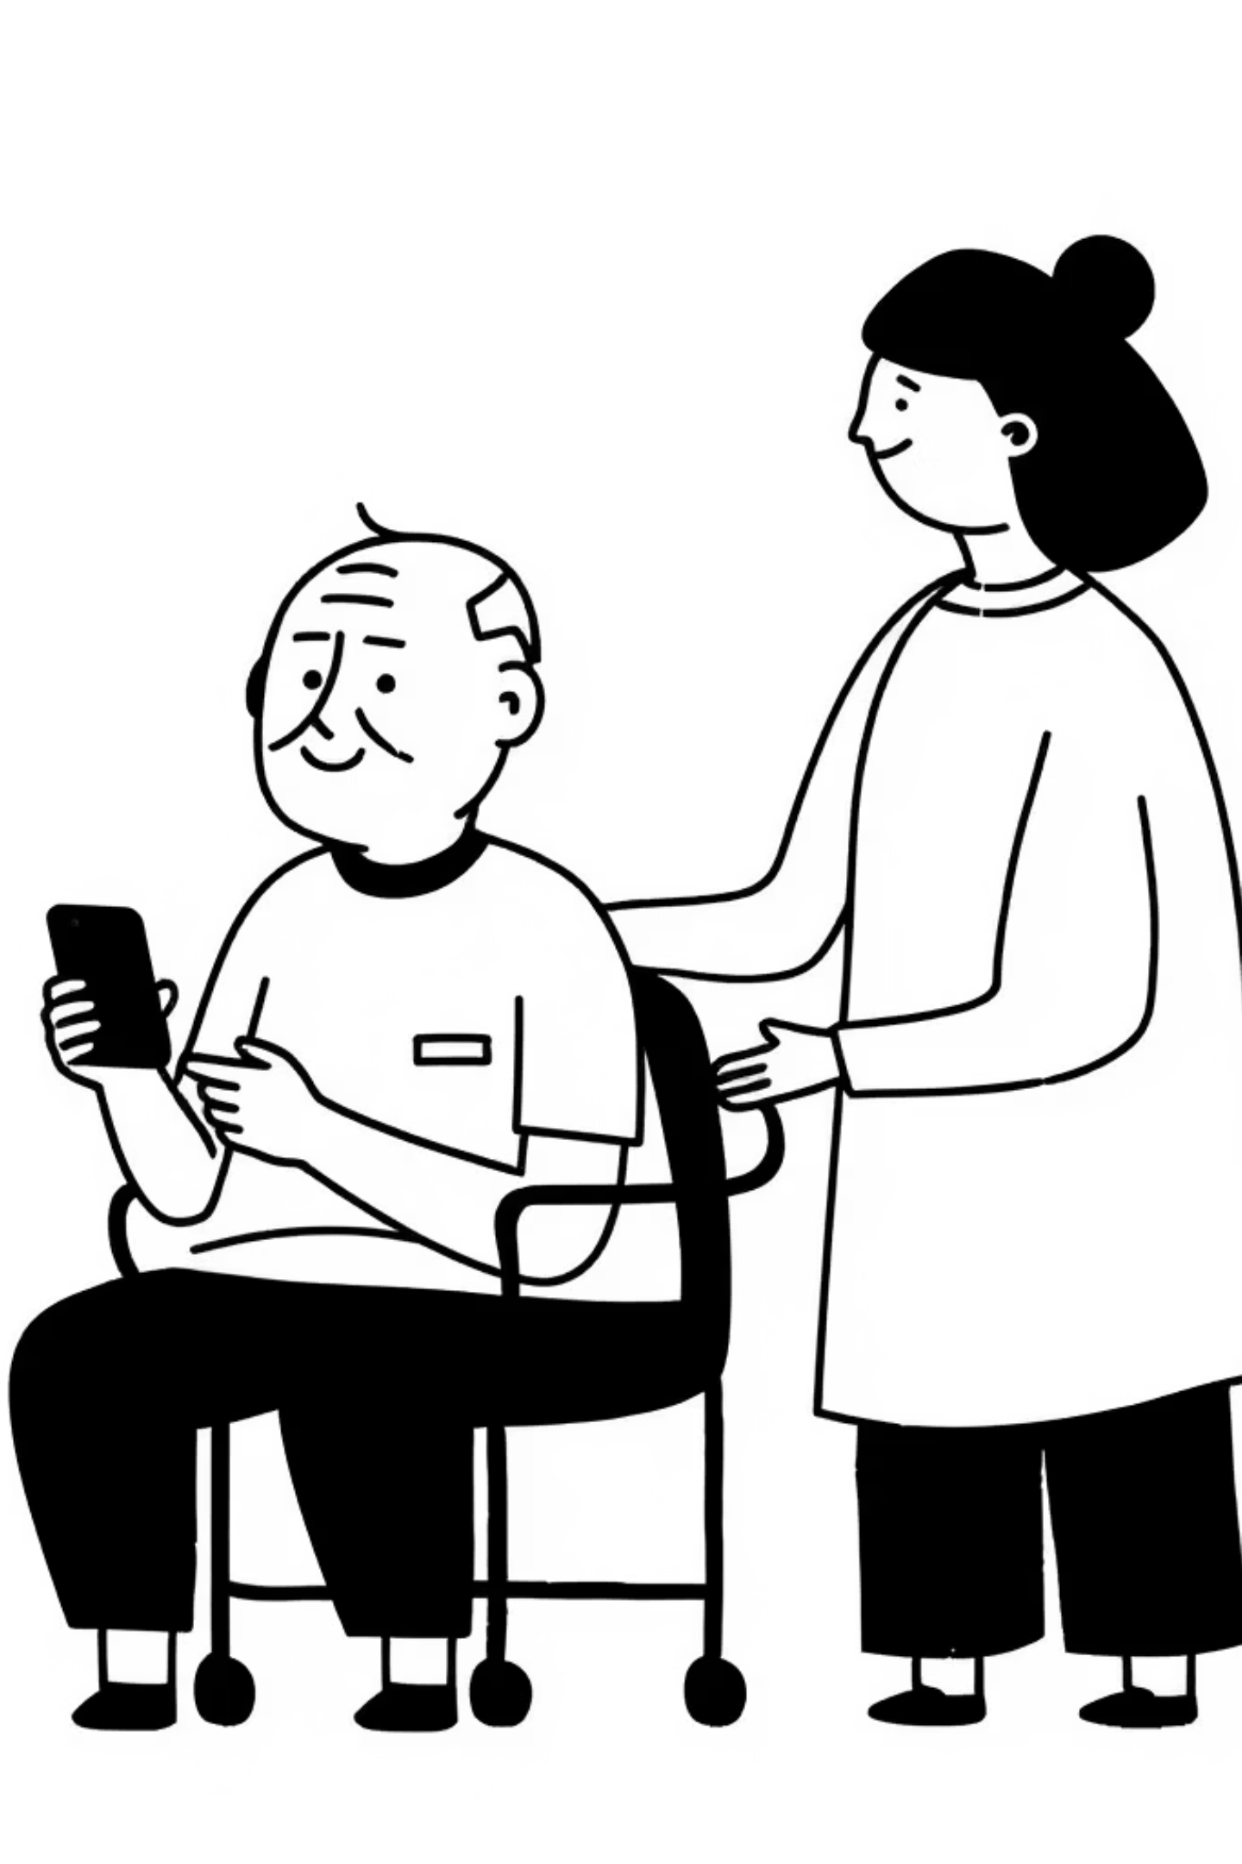
HealthConnect:
Bringing Healthcare to
Rural India
Presented by: Code Elites
Dhaanish Ahmed College of Engineering

Slide 2
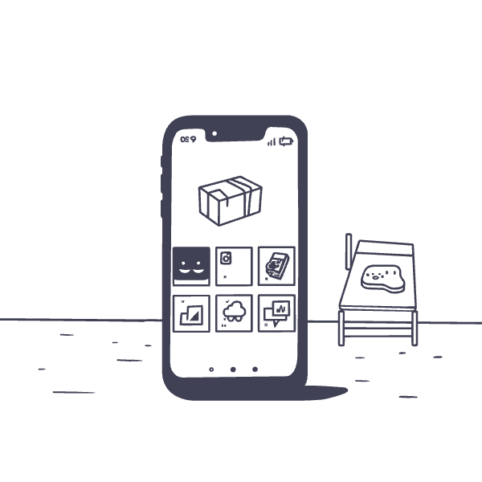
The Problem
Villages lack access to nearby hospitals
Transport is costly and time-consuming
Lack of timely diagnosis worsens conditions
Low awareness about preventive healthcare
Poor network connectivity in rural areas

Slide 3
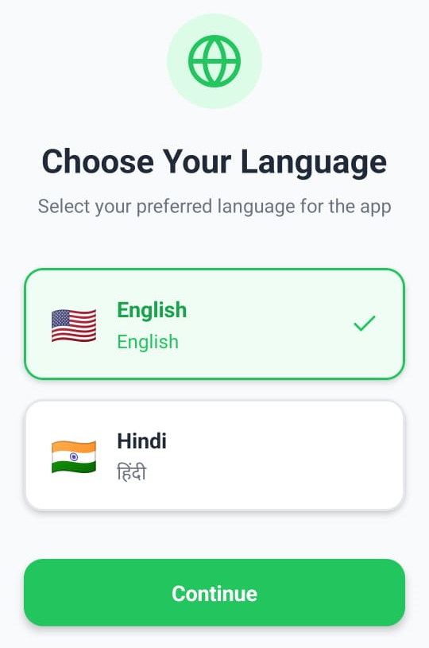
The Solution: HEALTHCONNECT
HealthConnect is a mobile application designed to bridge the healthcare gap in rural India
Mobile app designed for rural communities
Direct access to doctors through video & chat
Digital medical records stored securely
Health tips in simple, local language
Works in weak or unstable internet situations

Slide 4
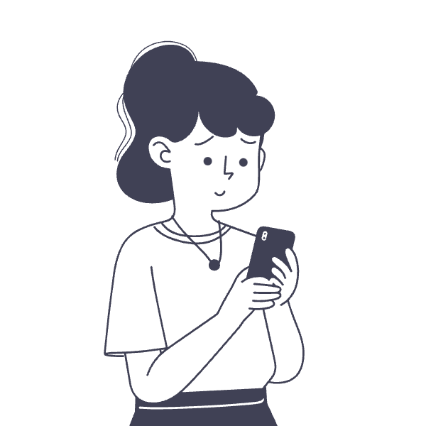
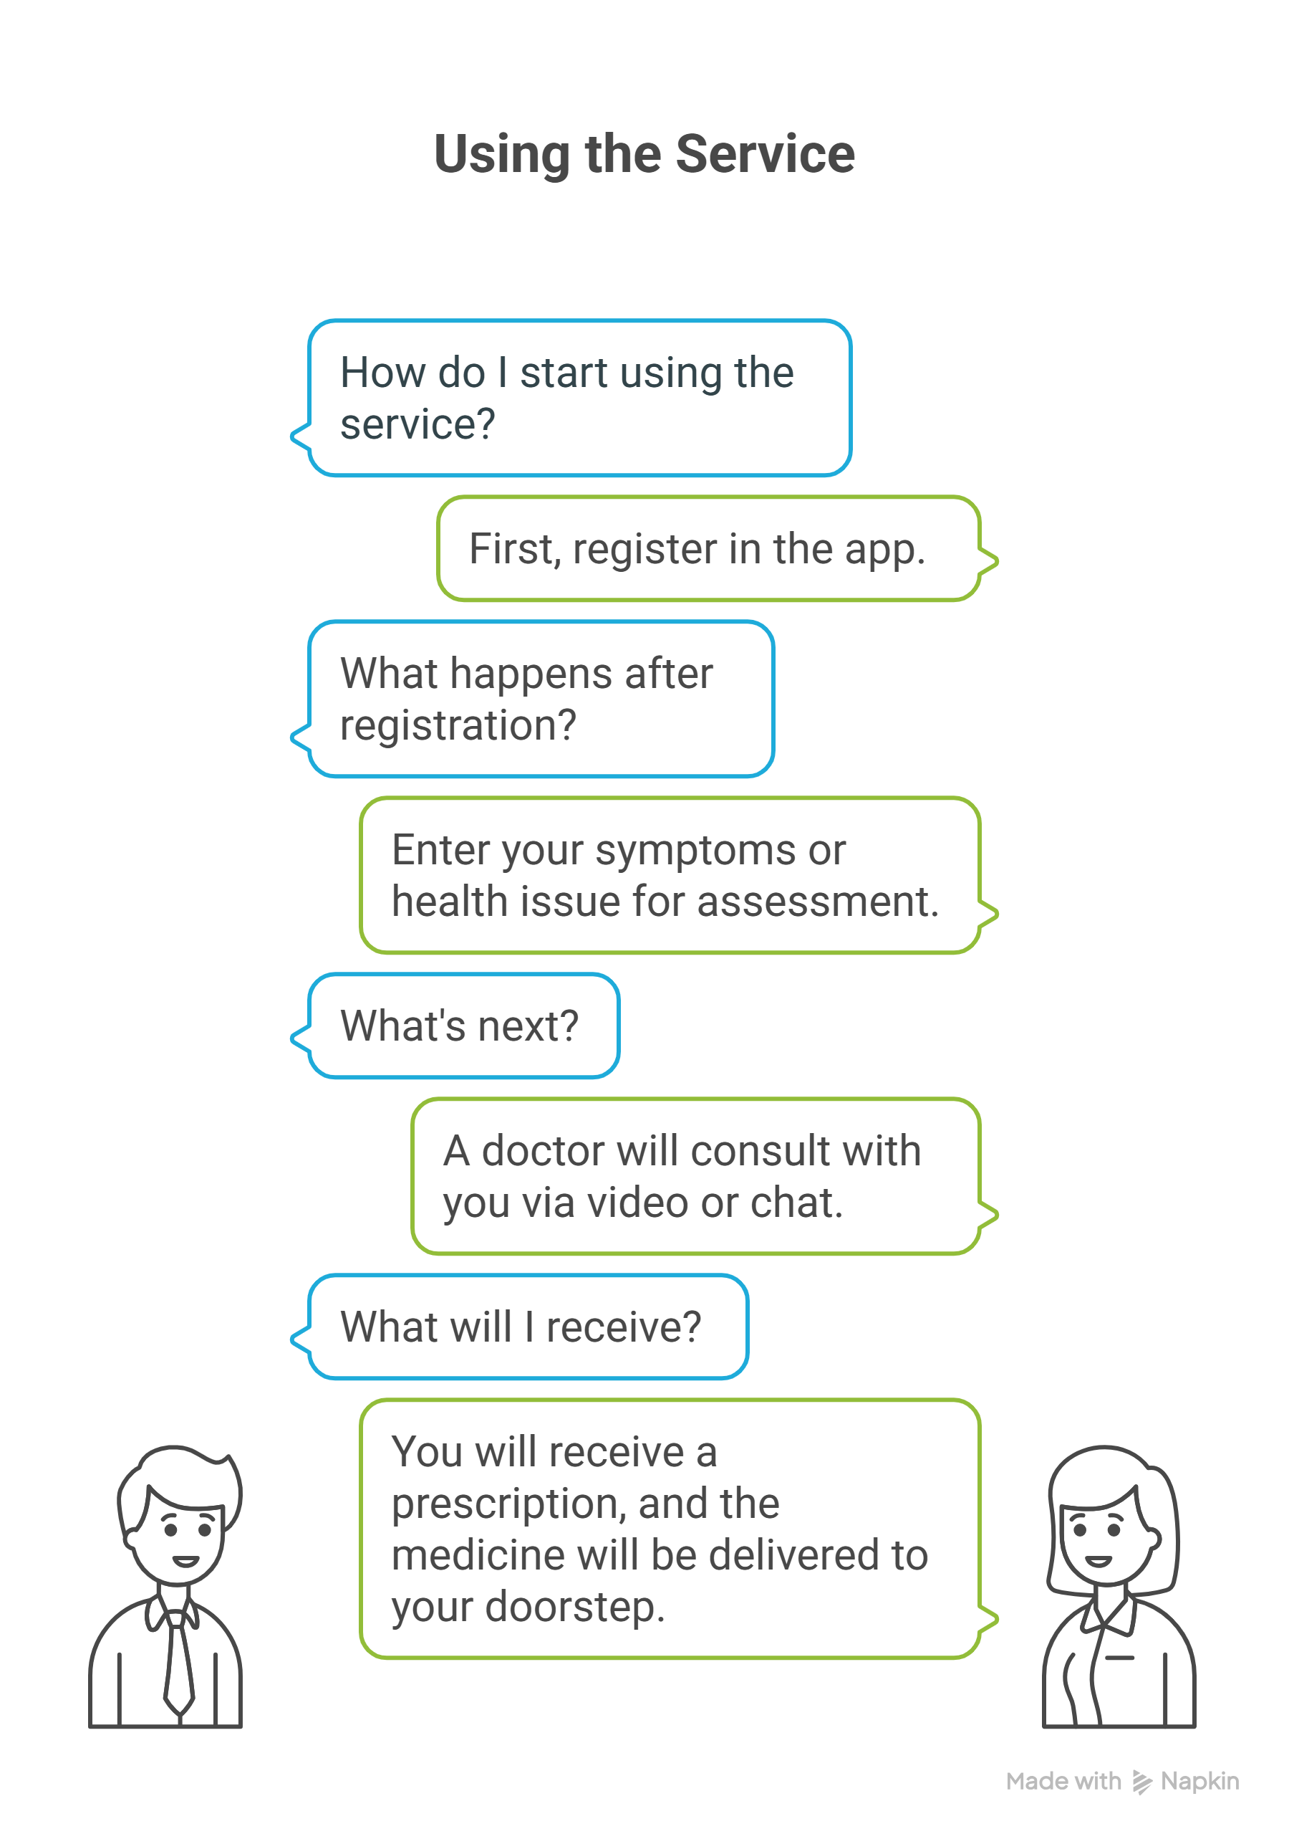
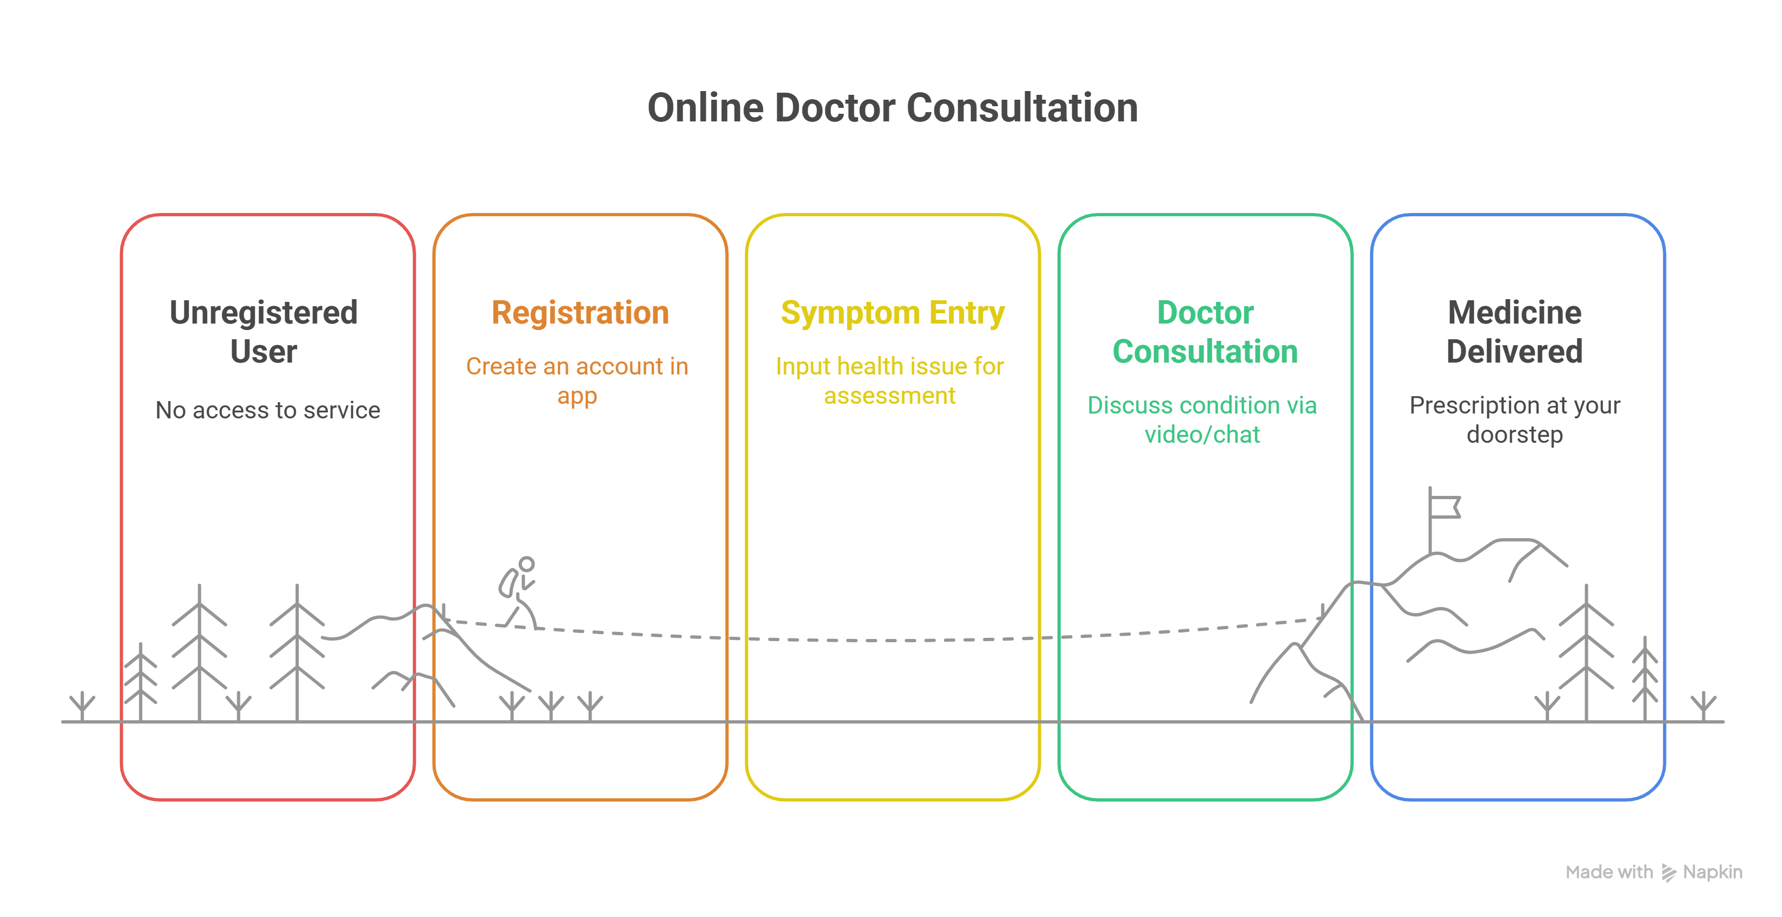
How It Works

Slide 5
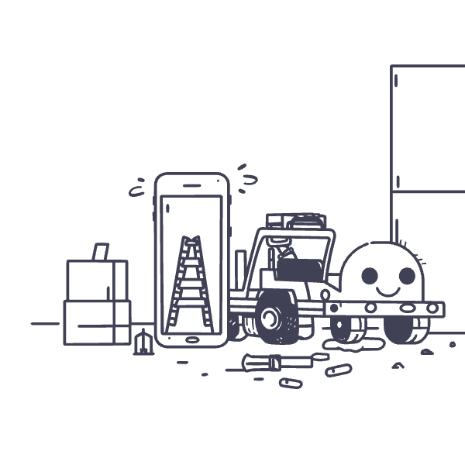
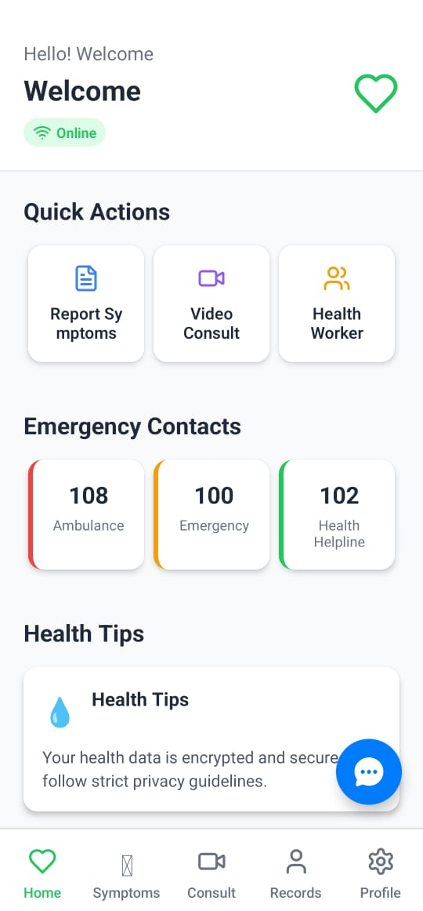
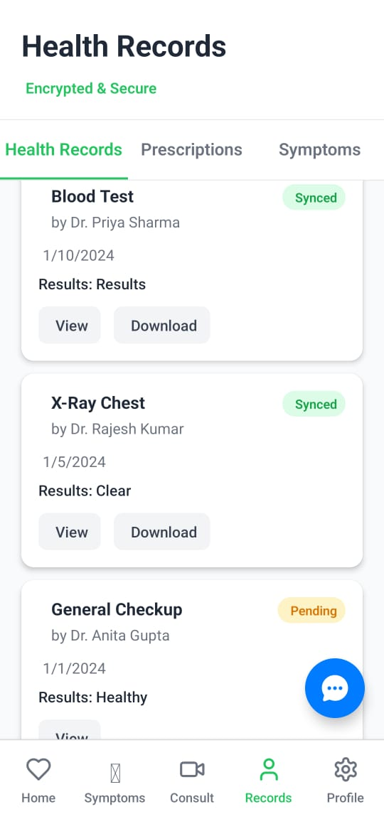
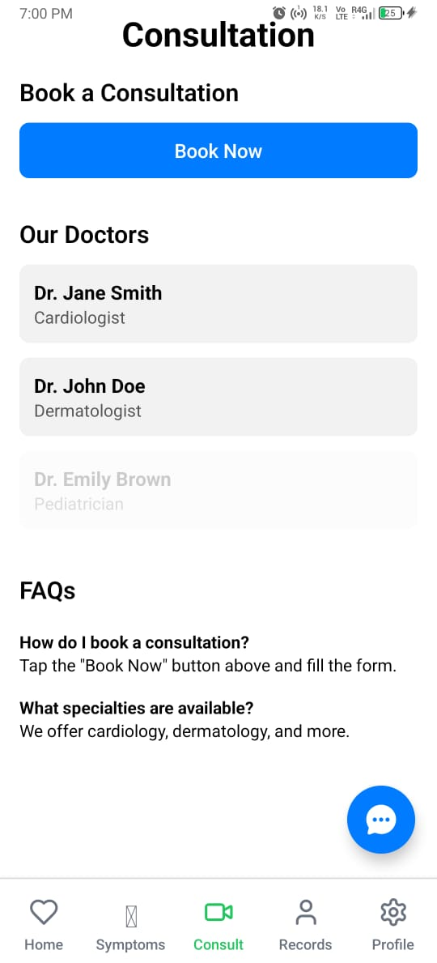
Unique Features
Minimal data usage, runs on poor connections
Local language support
Community health worker integration
Low-bandwidth optimization (2G/3G friendly)
AI-based early detection, doorstep medicine delivery

Slide 6
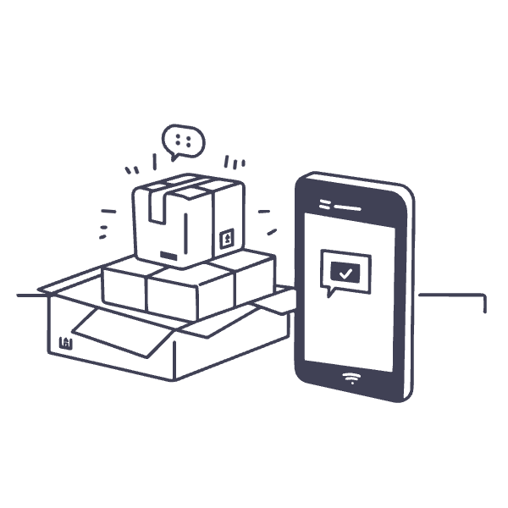





Technology Stack
React Native → Android & iOS app
Node.js + Express.js → Backend
MongoDB → Store patient records
Twilio → Video calls & SMS
Razorpay → Secure payments

Slide 7
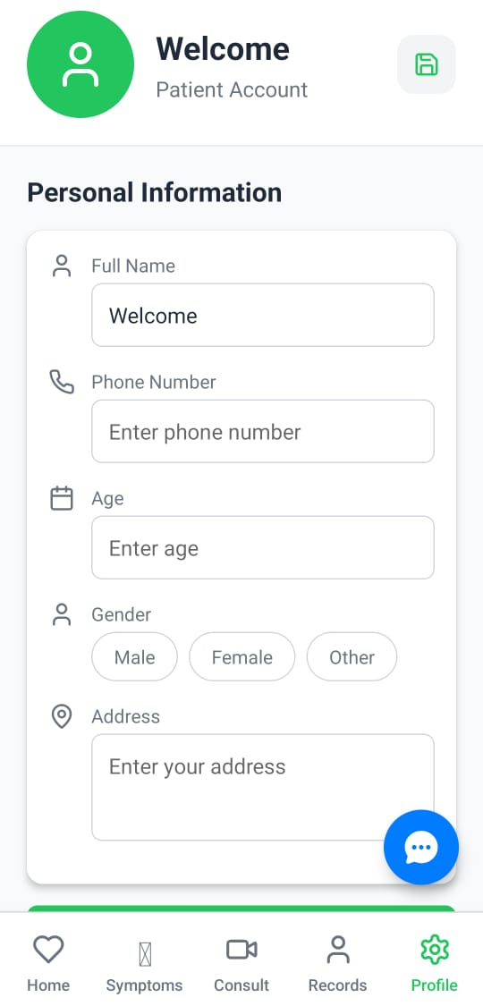

App Features
Registration & Login
Home Page
Simple onboarding for villagers
Multiple local languages supported
Easy navigation for user patients
Quick access: Doctors, Records, Health Tips

Slide 8

App Features
Doctor Consultation
Health Records
Direct video calls with doctors
Secure & private chat
Digital prescription given
Safe digital storage of patient history
Accessible anytime, anywhere
Shareable with doctors securely

Slide 9
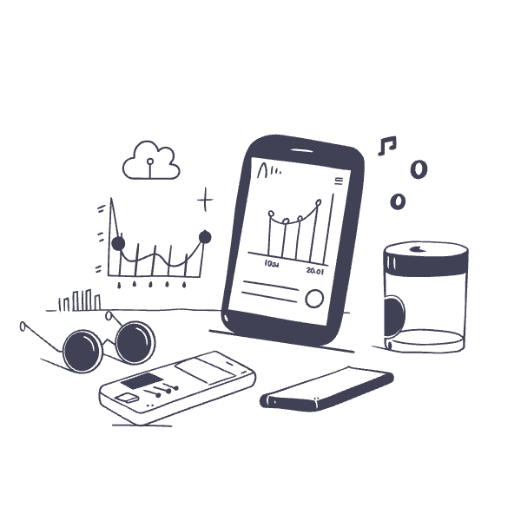



Conclusion
Healthconnect –
Accessible, Affordable, Reliable
Built for rural India by understanding their need
Nationwide expansion through
NGO and Government partnerships.
Now, let's experience HealthConnect in action.

